Slide 1
Team 11:
Course
Feedback
Christine Tye
Sriram Mohan
Quynh-anh Nguyen

Slide 2
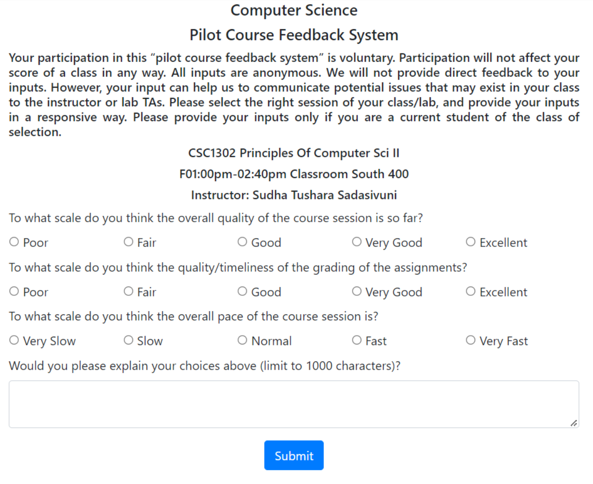
Purpose & Functionality
Recreate course feedback system on mobile app for ease of access
Users respond anonymously
If user is on GSU wifi/VPN, access is granted
If user is not on GSU wifi/VPN, access is denied
Prompts 3 multiple-choice questions and 1 free response question

Slide 3



Technical Platforms
Hybrid frameworks: cross platforms
Fast applications
Integrates well for older devices
IDE used to create mobile app
SQL-based: will integrate well with existing university database

Slide 4
Database Structure
The application is going to make use of two tables: for feedback and course, respectively.
Their table structures are as given:
yellow field - primary key
blue field - foreign key
normal text - integer
italics - string
Feedback
feedback_id
course_id
overall_quality
grading_quality
overall_pace
free_response
Course
course_id
course_name
course_title
instructor
semester
section

Slide 5
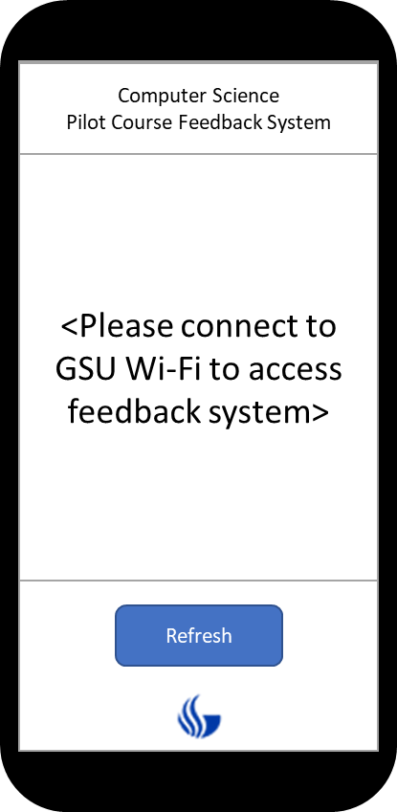
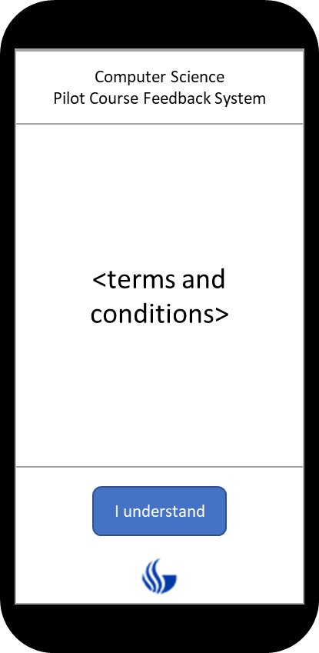
Storyboard 1:
Check VPN
App checks whether VPN matches GSU’s wifi
If pass, terms and conditions load
User selects “I understand”

Slide 6
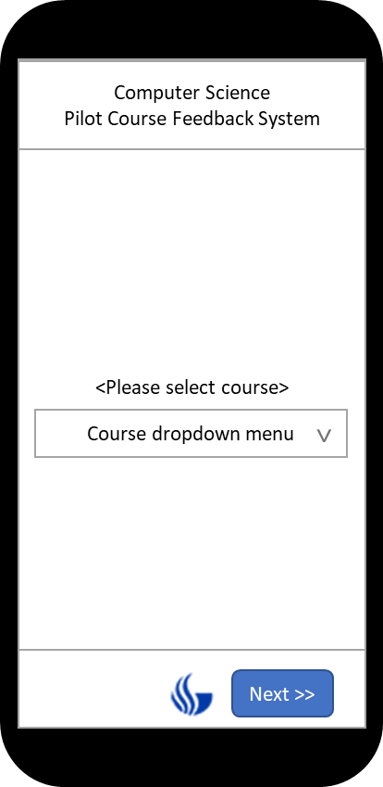
Storyboard 2:
Select Course
App queries database for course list, displays in dropdown
User selects course
User selects “Next”

Slide 7
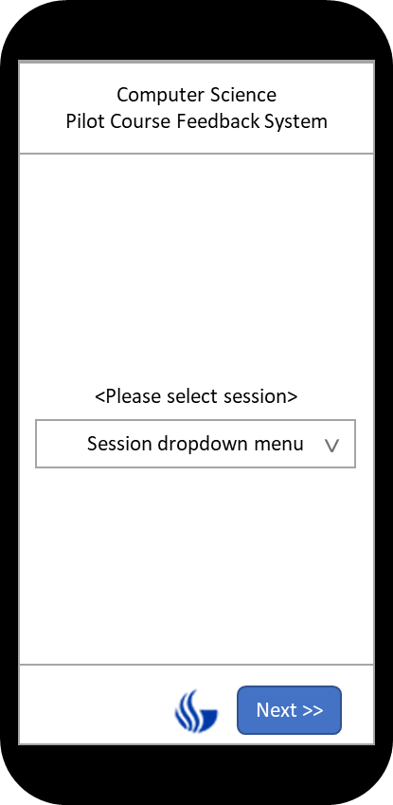
Storyboard 3:
Select Session
App queries database for sessions of selected course (if course has multiple sessions)
User selects session
User selects “Next”

Slide 8
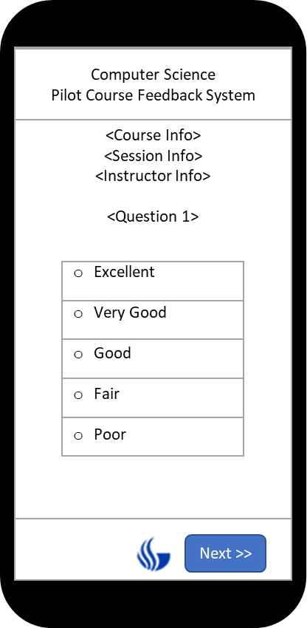
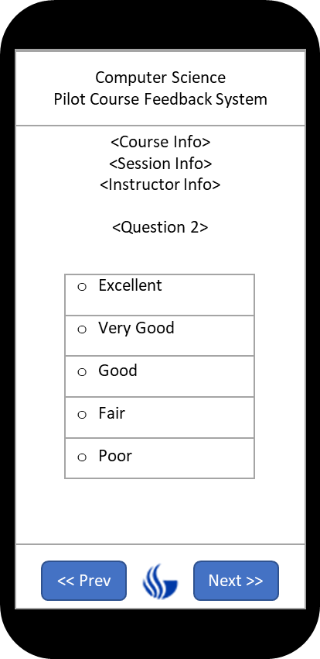
Storyboard 4:
Single Selection Questions
App displays questions and choices
User selects a choice for each question
“Next” button will not work until user selects a response.
User navigates via “Prev” and “Next” buttons

Slide 9
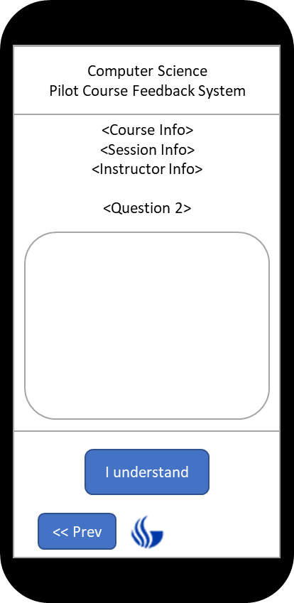
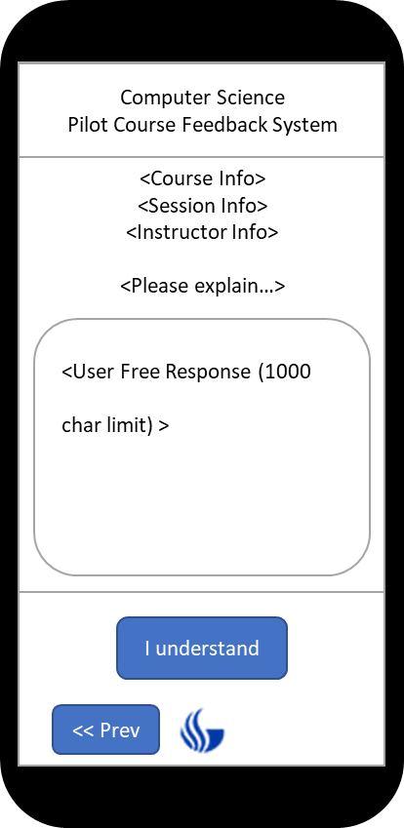

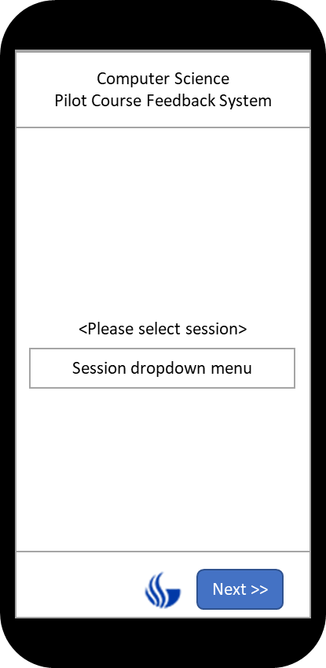
Storyboard 5:
Free Response
Text box for user free response
User inputs free response
“Submit” button will not work until user inputs free response
User can navigate to prior questions using “Prev” button

Slide 10
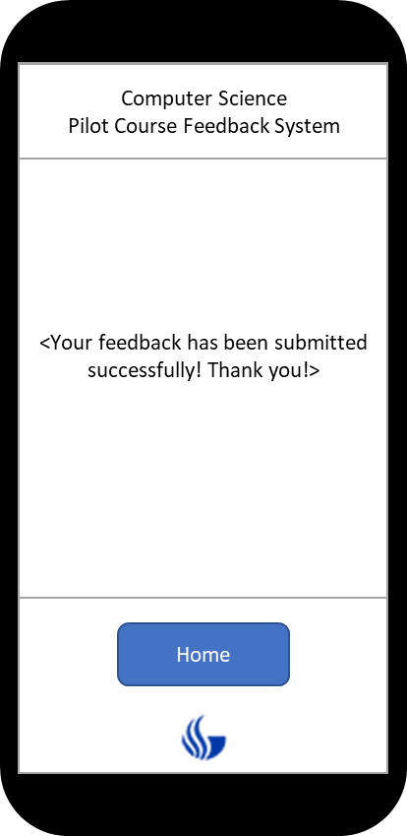
Storyboard 6:
Submission Successful
User’s responses are stored in the database
Clicking “Home” will bring user back to the Terms and Condition page.

